Slide 1




Weekly report: Load & Dynamics
Week number: 07
Date: 11/11/2025
Supervisor: Mr. Manjock
Group members: Md Aman, Arham Memon, Paresh Nakum
Presenter – Arham Memon
11/11/2025
Md Aman, Arham Memon, Paresh Nakum
Optimus Syria

Slide 2
Agenda For Loads & Dynamics
DLC 1.2
DLC 4.X
Updated DLC 5.1
Conclusion & Future Plan
Bibliography
11/11/2025
Arham Memon
Load & Dynamics Team/ Optimus Syria

Slide 3
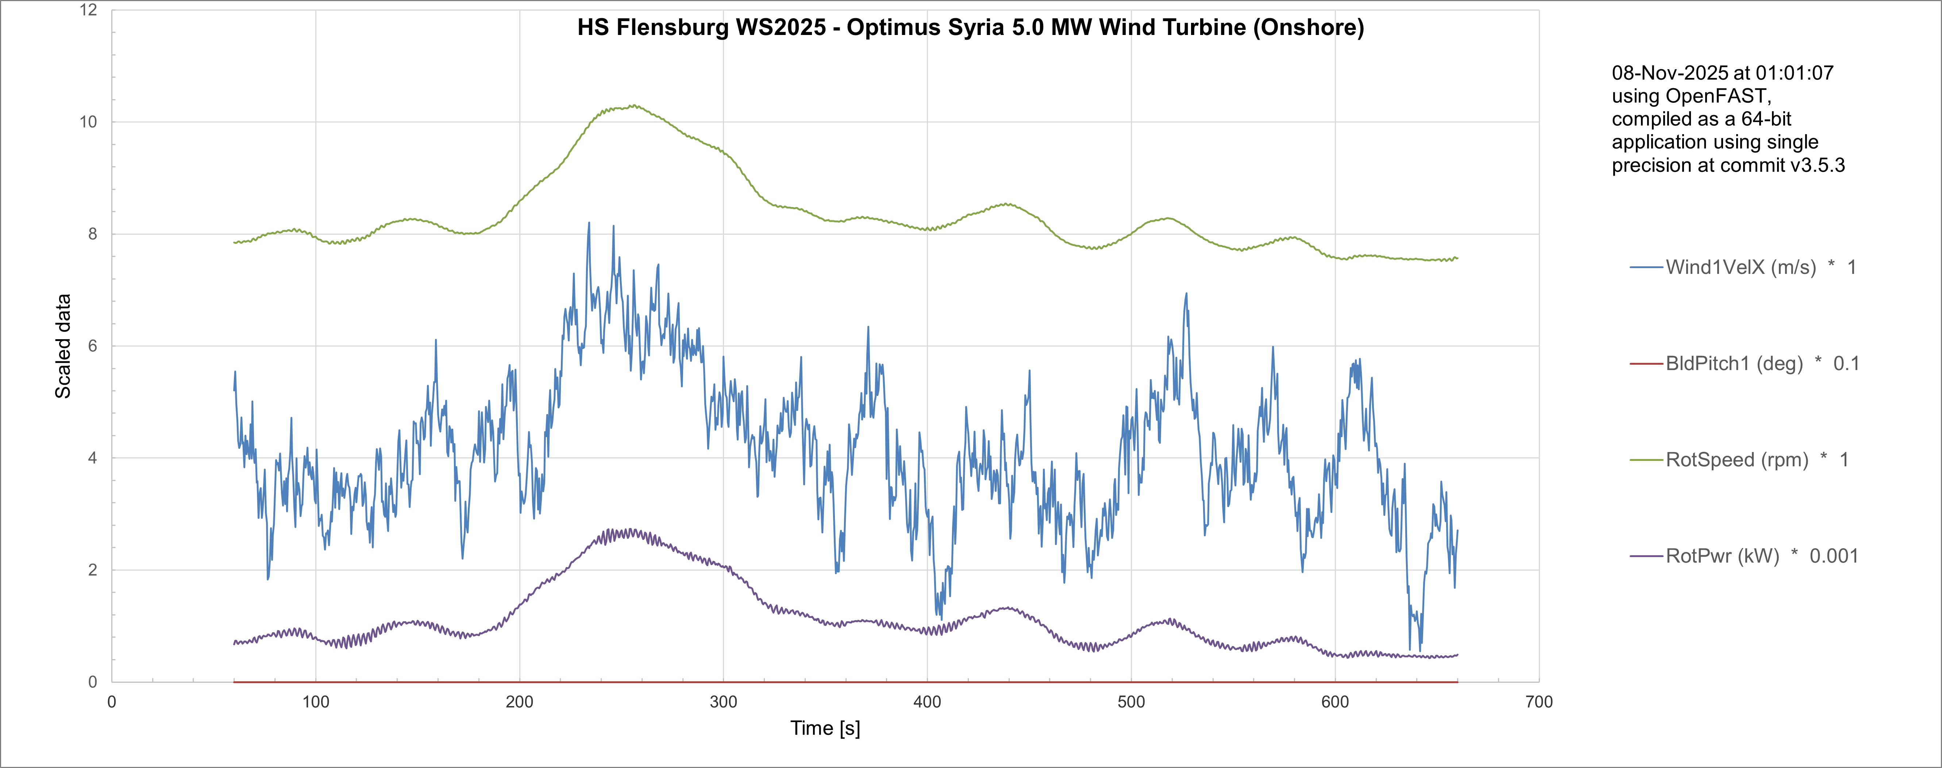
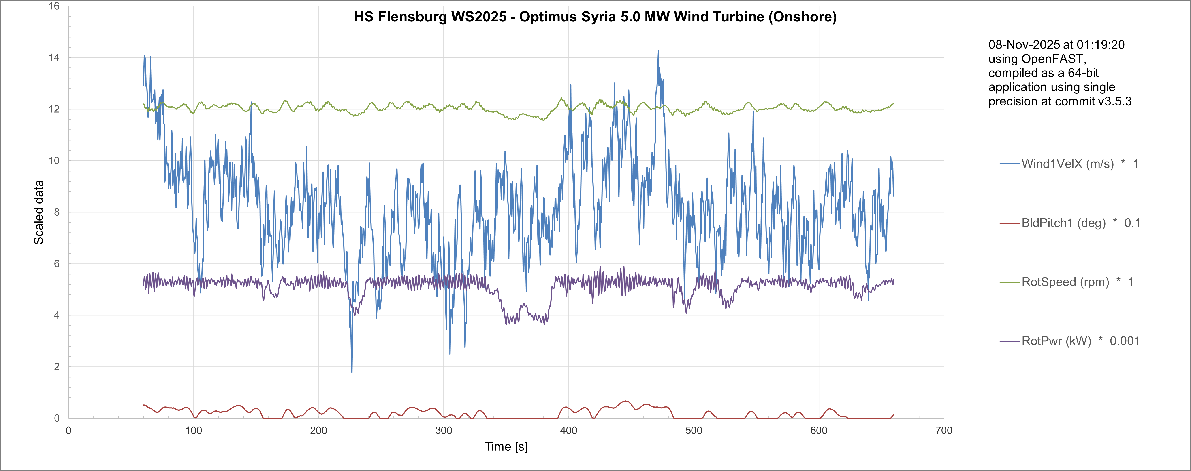
DLC 1.2 Power Production(NTM)
Purpose: To confirm the turbine can safely operate and its control system can effectively manage the rotor speed and power under day-to-day high turbulent conditions (Normal Turbulence Model, NTM).
4 m/s
8.64 m/s
11/11/2025
3
Arham Memon
Load & Dynamics Team/ Optimus Syria

Slide 4
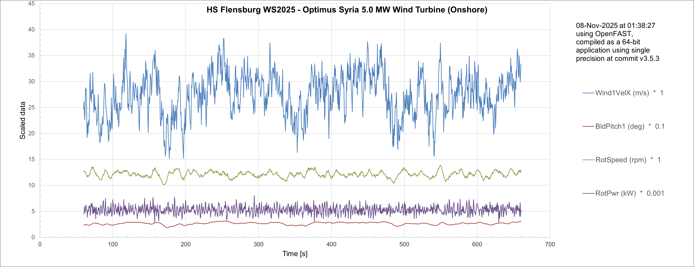
DLC 1.2
28 m/s
11/11/2025
4
Arham Memon
Load & Dynamics Team/ Optimus Syria

Slide 5
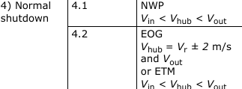
DLC 4 Normal Shutdown
This design situation includes all the events resulting in loads on the wind turbine during normal transitions from power production to stand-by condition (standstill or idling).
Normal Wind Profile
Extreme Operating Gust
Term | What it Represents | Main Use
NTM | Fluctuations/turbulence stats | Simulating gusty, turbulent wind for load/fatigue analysis
NWP | Mean wind speed vs. height | Defining standard background wind field for simulations
EOG | Gust event during which shut-down occur | stressing the need for combined event simulation to capture realistic turbine responses.
11/11/2025
5
Arham Memon
Load & Dynamics Team/ Optimus Syria

Slide 6
DLC 4.X
Case | Turbine State | Typical Wind Model
DLC 4.1 | DLC 4.1 requires annual fatigue analysis of wind turbines using at least 1000 shut-downs at cut-in, 50 at rated, and 50 at cut-out wind speeds, considering site-specific curtailment needs.​ | NTM
DLC 4.2 | DLC 4.2 analyzes turbine shut-downs coinciding with extreme operating gusts (EOG) at various timings and rotor azimuths, ensuring loads from combined events are realistically simulated for structural safety. | EOG/ETM(alternative)
11/11/2025
6
Arham Memon
Load & Dynamics Team/ Optimus Syria

Slide 7
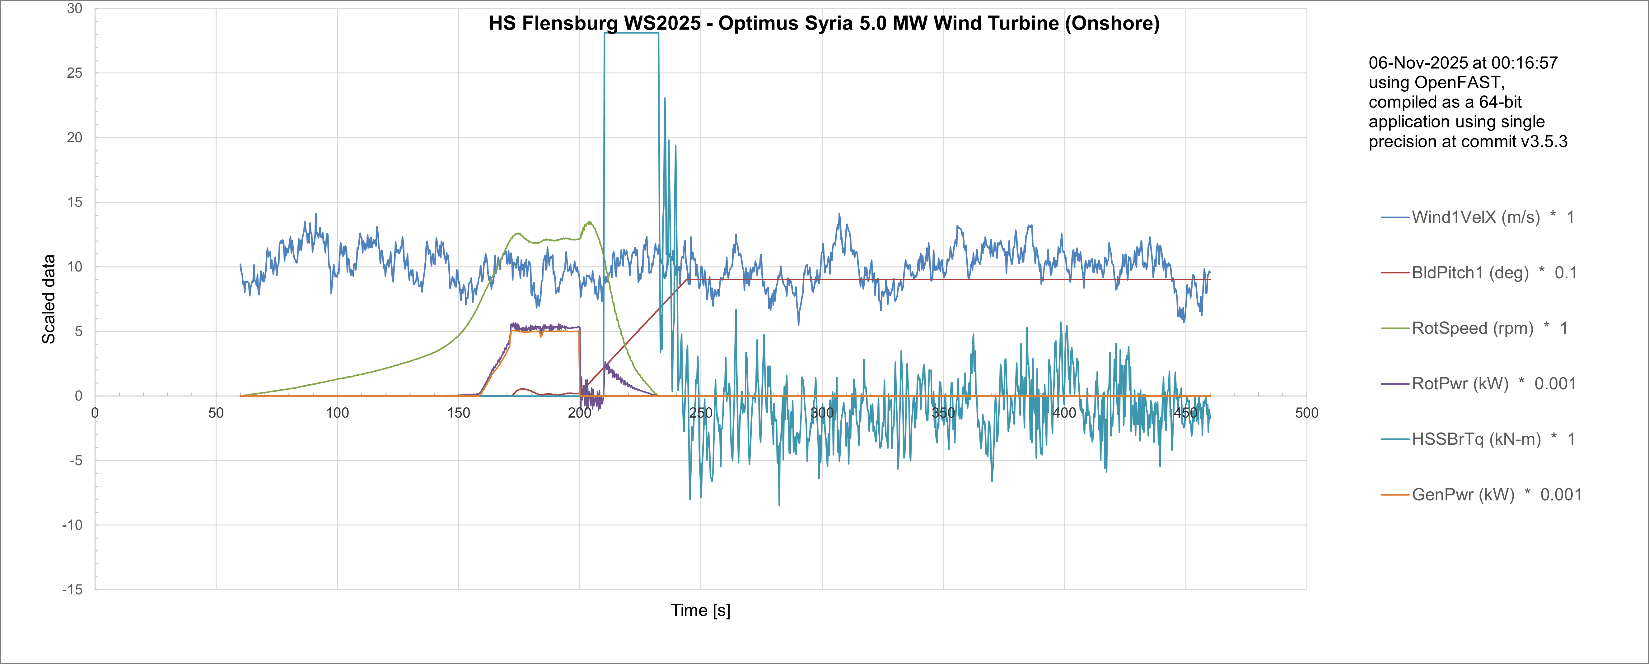
DLC 5.1Emergency Stop
This load case covers manual actuation of the emergency stop pushbutton. For this load case, the rotor shall be brought to a standstill.
Update from last week
11/11/2025
Arham Memon
Load & Dynamics Team/ Optimus Syria

Slide 8
Conclusion & Future Plan
In the last week we
Configured Wind Simulations for NTM for DLC 1.2
Update Simulation with DLC 5.1
Analyzed DLC 4.X cases
Provided forces and moments at different section of turbine to other teams
In the next week
Start Simulations with DLC 4.X
Simulate OpenFAST for updated parameter of turbine
Configure Simulation with other DLC Cases
Work with different groups
Start Calculation of MExtremes
11/11/2025
8
Arham Memon
Load & Dynamics Team/ Optimus Syria

Slide 9
References
Load Reports of the OPTIMUS projects
GL Guideline for the Certification of Wind Turbines Edition 2010
Standard, DNVGL-ST-0376 – Edition December 2015
IEC 61400-1 2019-02, Ed. 4.0/ DNVGL-ST-0437 Loads and site conditions for wind turbines 11-2016
TurbSim, OpenFAST & NREL 5 MW
11/11/2025
9
Arham Memon
Load & Dynamics Team/ Optimus Syria

